Slide 1


tiered website packages for state agencies
PREPARED BY THE OFFICE OF INFORMATION TECHNOLOGY SERVICES | AUGUST 2024

Slide 2
three tiers
GLOBAL FEATURES
Section 508 / ADA Compliance (Web Accessibility)
Built with WordPress platform so each agency can manage their own content
Site metrics through Google Analytics
Ongoing hosting and site maintenance to ensure your site is working and secure
Discovery planning —we work directly with you to identify and develop your messaging, focus, and goals of the site
Optimized for desktop and mobile experiences
Features include blog, events, search, contact form, and more

Slide 3
tier one

Slide 4
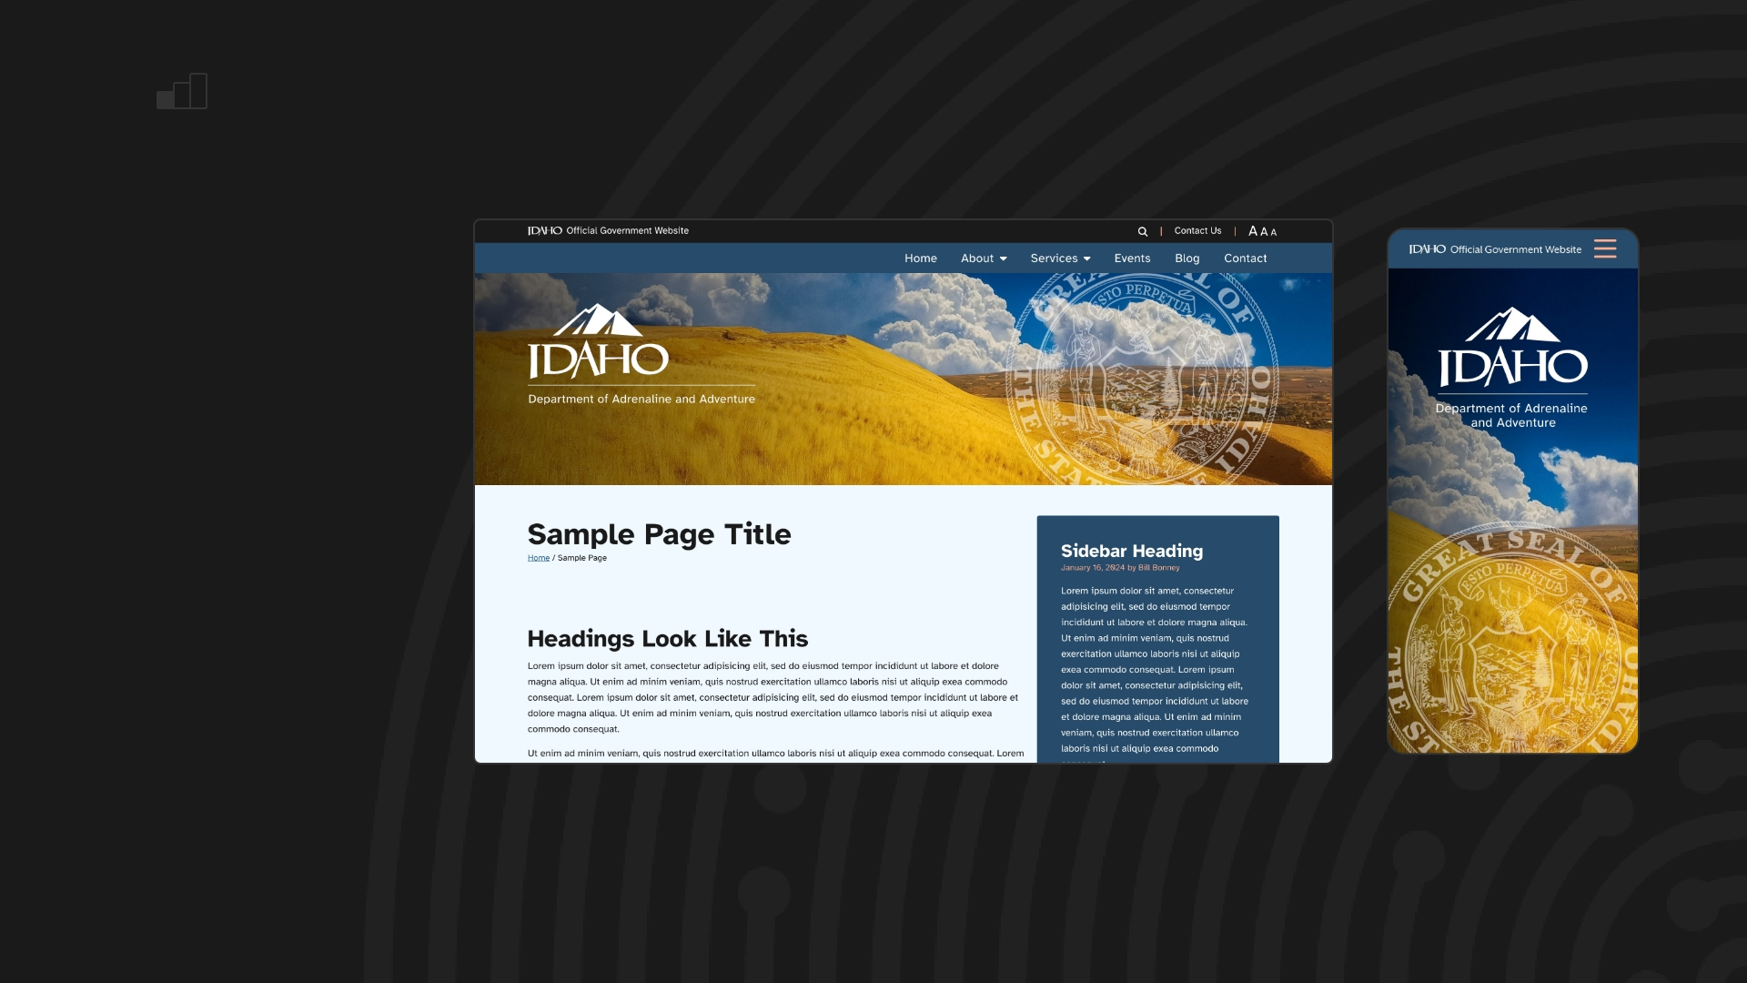

TIER ONE
Webmaster 4.0 Theme
2–3 weeks
Experience a fresh, out-of-the-box professional Idaho-agency-branded site! This seamless upgrade from the Webmaster 3.0 theme means no learning curve—just the same simple, familiar process for all your site updates.
“SKY”
[example]
“SKY” SKIN

Slide 5
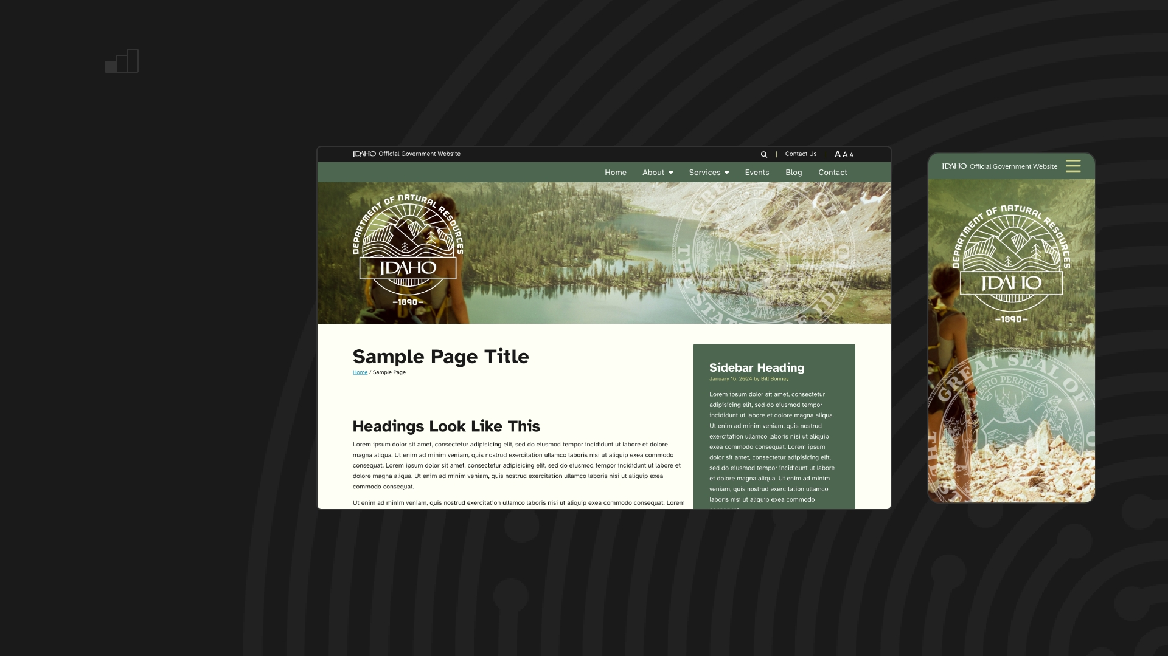

TIER ONE
Webmaster 4.0 Theme
2–3 weeks
Experience a fresh, out-of-the-box professional Idaho-agency-branded site! This seamless upgrade from the Webmaster 3.0 theme means no learning curve—just the same simple, familiar process for all your site updates.
“SAGE”
[example]

Slide 6
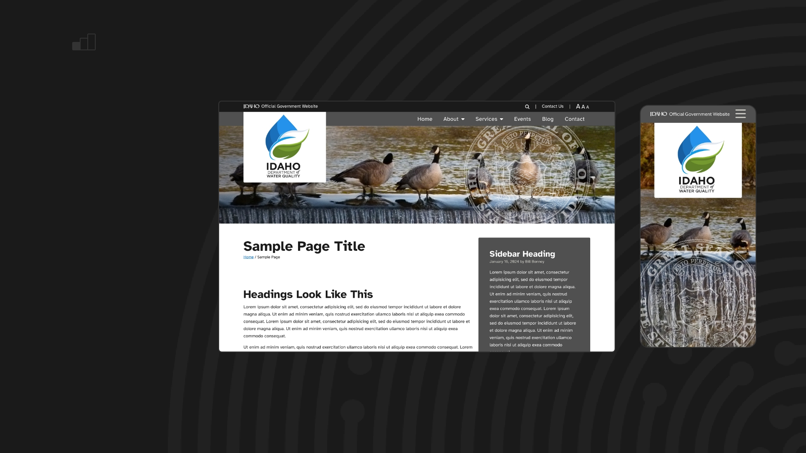

TIER ONE
Webmaster 4.0 Theme
2–3 weeks
Experience a fresh, out-of-the-box professional Idaho-agency-branded site! This seamless upgrade from the Webmaster 3.0 theme means no learning curve—just the same simple, familiar process for all your site updates.
“SMOKE”
[example]

Slide 7
tier two

Slide 8
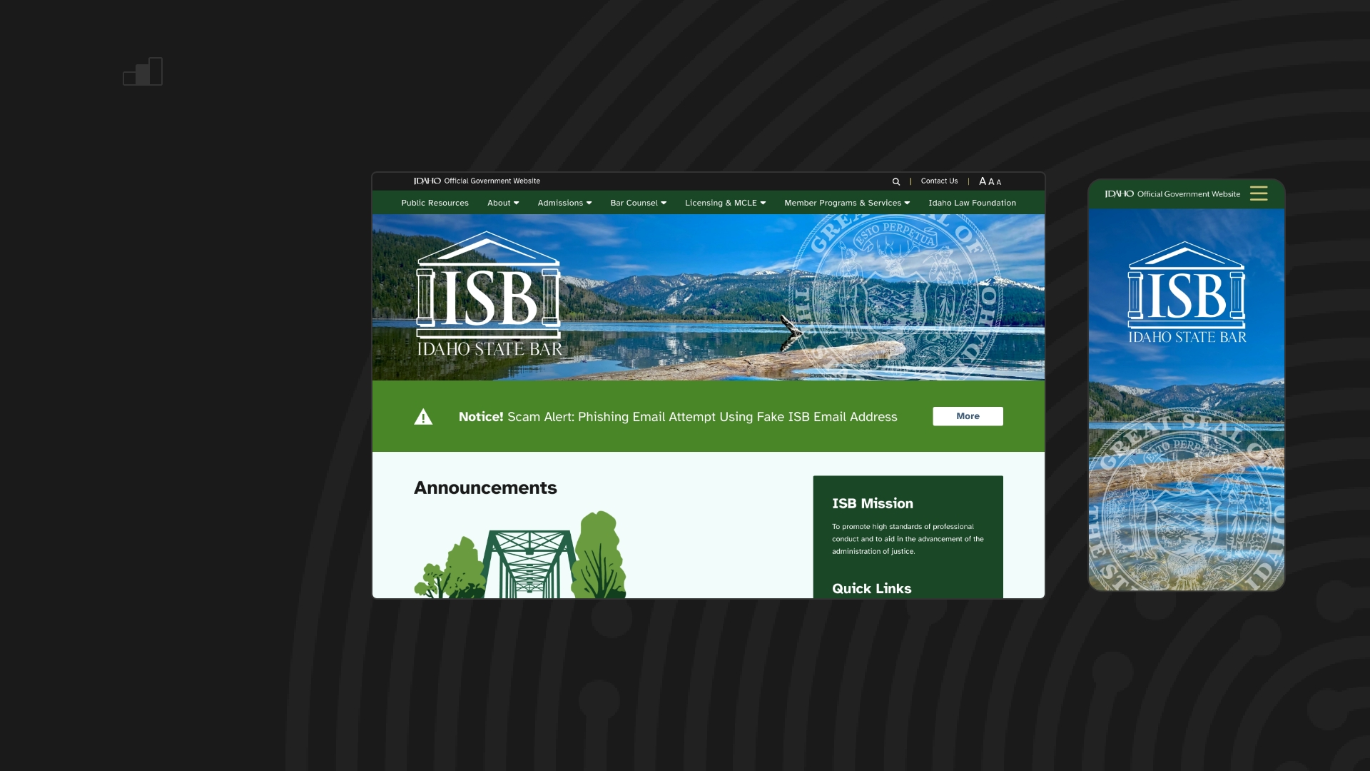
TIER TWO
Unique Webmaster 4.0 Theme
3–6 weeks
Introducing an updated Webmaster theme with a custom homepage design and tailored color palette. Plus, enjoy additional features, designed pages, and advanced forms—all while maintaining the same easy update process you’re familiar with.
CUSTOM ISB
[example]

Slide 9
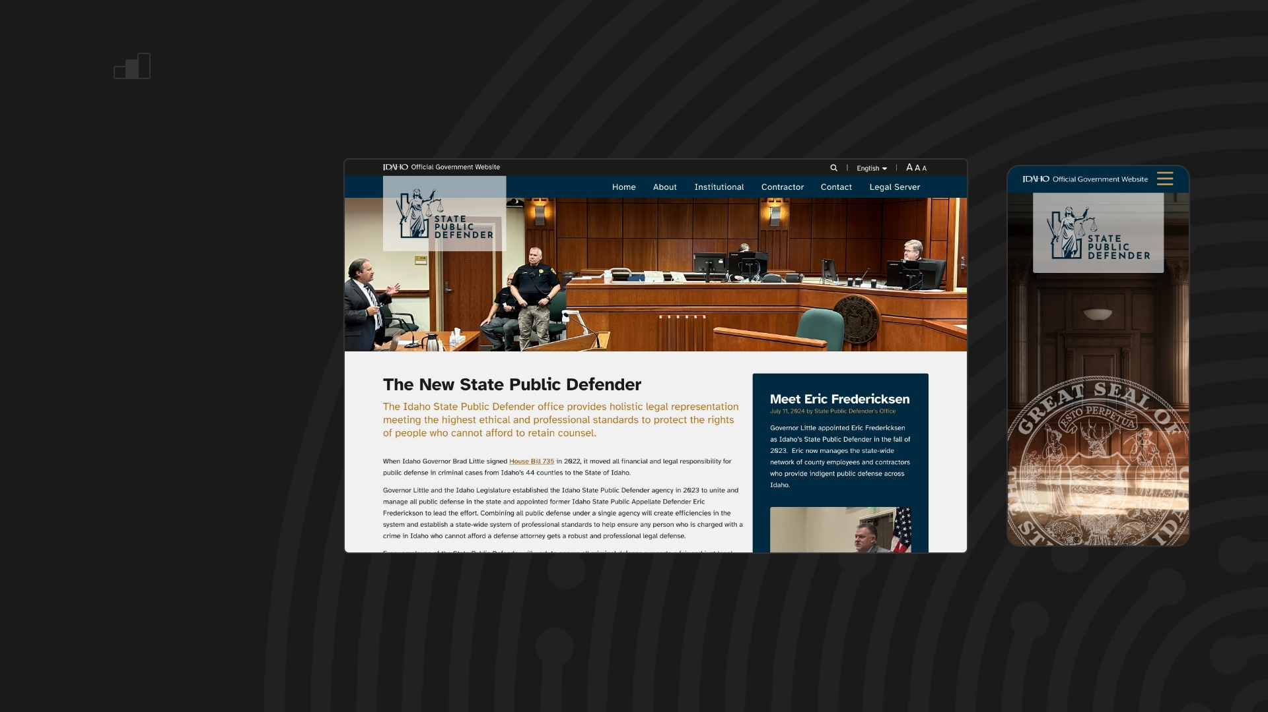
TIER TWO
Unique Webmaster 4.0 Theme
3–6 weeks
Introducing an updated Webmaster theme with a custom homepage design and tailored color palette. Plus, enjoy additional features, designed pages, and advanced forms—all while maintaining the same easy update process you’re familiar with.
CUSTOM SPD
[example]

Slide 10
tier three

Slide 11
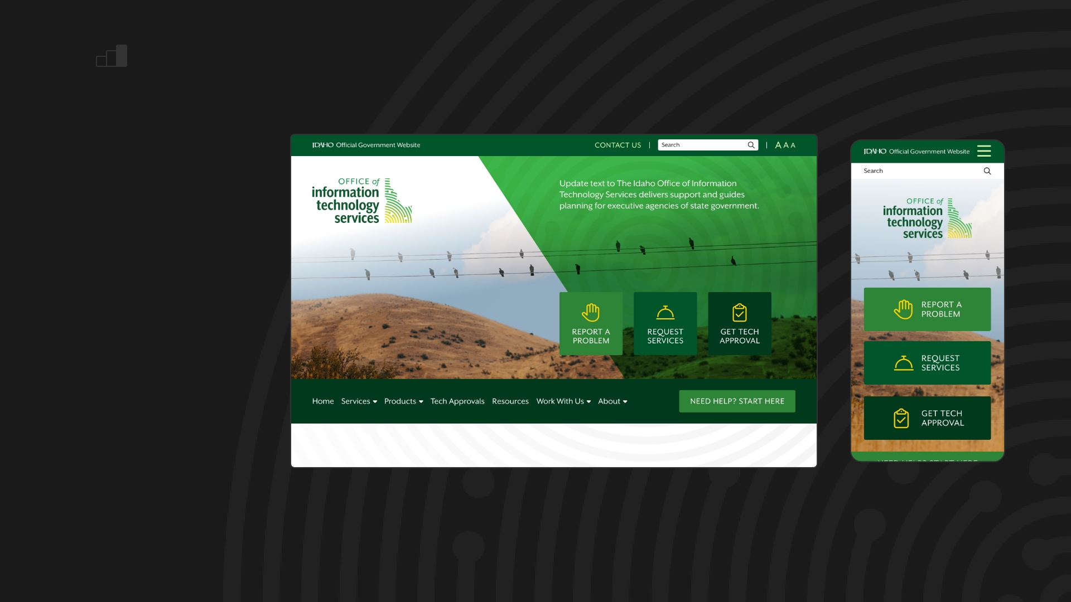
TIER THREE
Fully-Custom WordPress Theme
8–12 weeks
A fully custom website with a unique design and tailored visitor experience for your agency. This theme also offers advanced forms and additional features to enhance functionality.
FULLY-CUSTOM ITS
[example]

Slide 12
questions?

Slide 13
thank you!

